Slide 1

ZOMATO RESTAURANTs ANALYSIS
By Kiranjeet Kaur
25-01-2025

Slide 2
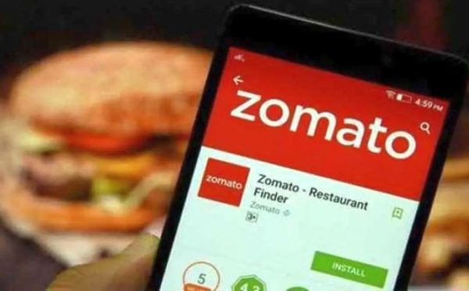
Unlocking the Flavor of Success: Unleashing Zomato's Expansion Potential
Did you know that the online food delivery market in India is projected to reach $15.5 billion by 2025, growing at a staggering CAGR of 30%?

Slide 3

Context
As a leading food delivery platform, Zomato aims to capitalize on this trend and expand its presence in the market.
Primary Objectives
This project seeks to:
Identify potential areas for expansion: Analyze demographic, market, and competitive trends to pinpoint high-growth areas for Zomato's expansion.
Understand market trends and preferences: Uncover insights on consumer behavior, preferences, and pain points to inform Zomato's menu offerings, marketing strategies, and operational improvements.
Inform data-driven decisions: Provide actionable recommendations to Zomato's leadership team, enabling informed decisions on expansion, marketing, and operational strategies.
.

Slide 4

Data Overview
Dataset Summary
Total number of restaurants:9951 restaurants across 15 different countries.
Total number of cities: 141 unique cities.
1825 different cuisine offerings.
Average rating 2.89 indicates customer behaviour.
Data Cleaning and Preprocessing
Separated currency symbol from text.
Average cost for two values were converted to Indian Rupees (INR).
The year was extracted from the date field, providing a clear timeline for analysis.

Slide 5

Why This Data is Critical
Identifies Market Trends: Restaurant data reveals market trends,
popular cuisines, and pricing strategies.
Inform Expansion Strategy: Location data and restaurant density
help identify areas for expansion.
Understand Customer Behavior: Review data and ratings
provide insights into customer preferences and satisfaction.
Competitor Analysis: Data on restaurants, pricing, and services
enables competitor analysis and benchmarking.
Optimize Operations: Data on delivery options, table booking,
and pricing helps optimize restaurant operations and services.

Slide 6




Analytical Approach and Tools
Highlighted rows where newer restaurants can be open using Conditional formatting.
Descriptive Analysis: Made pivot tables for identifying the distribution of restaurants across different regions, popular cuisines , ratings and average dining cost for two people in different regions.
Visualization: Created dynamic charts and dashboard for data representation, enabling interactive data exploration.
Data Enrichment: Enhanced
the dataset with country name using
VLOOKUP,
extracted year from date and currency
symbol from currency.
Trend Analysis: Identified patterns and trends in customer reviews, ratings, and restaurant characteristics.
Correlation Analysis: Examined relationships between variables (e.g., price range and customer satisfaction).

Slide 7
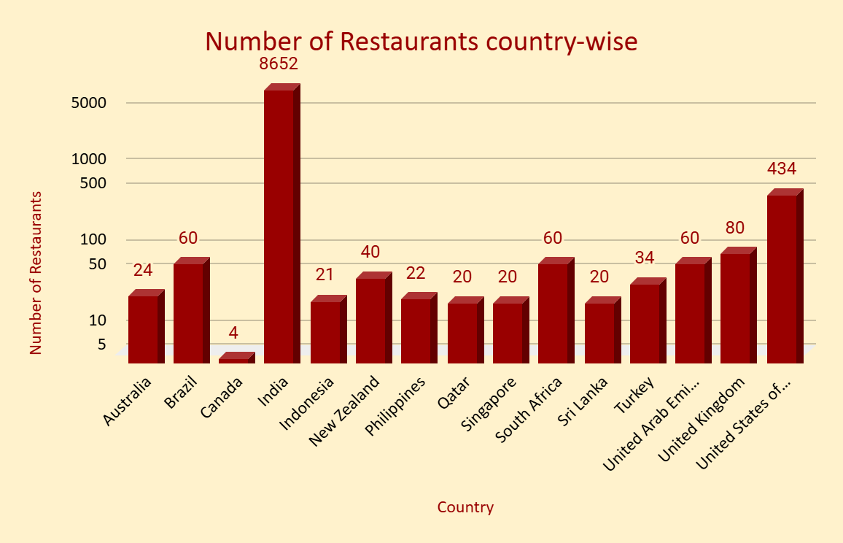
In the above chart we have different countries with the count of the restaurants.
We found that India with the largest population has a large number of in it i.e.,8652 restaurants in it.
Then comes the United States with 434 restaurants and finally third country is United Kingdom with 80 restaurants.

Slide 8
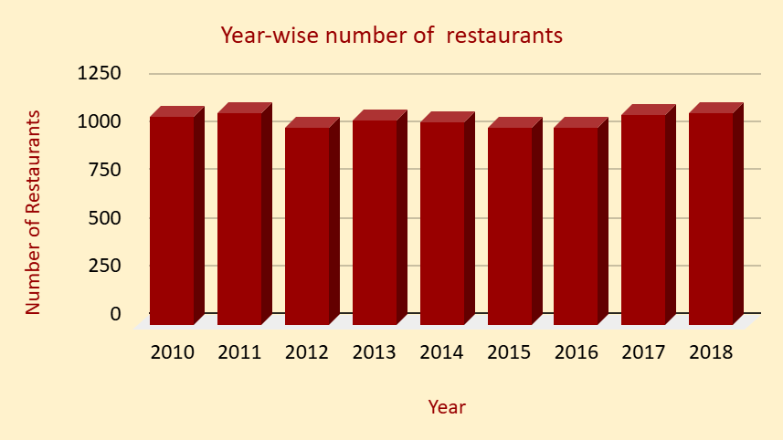
In this chart we have a number of restaurants opened every year.
We found that the largest number of restaurants opened in 2018 i.e. 1102 and then 2011 i.e.1098.
The least number of restaurants opened in the year 2012 and 2015 i.e.1022.

Slide 9
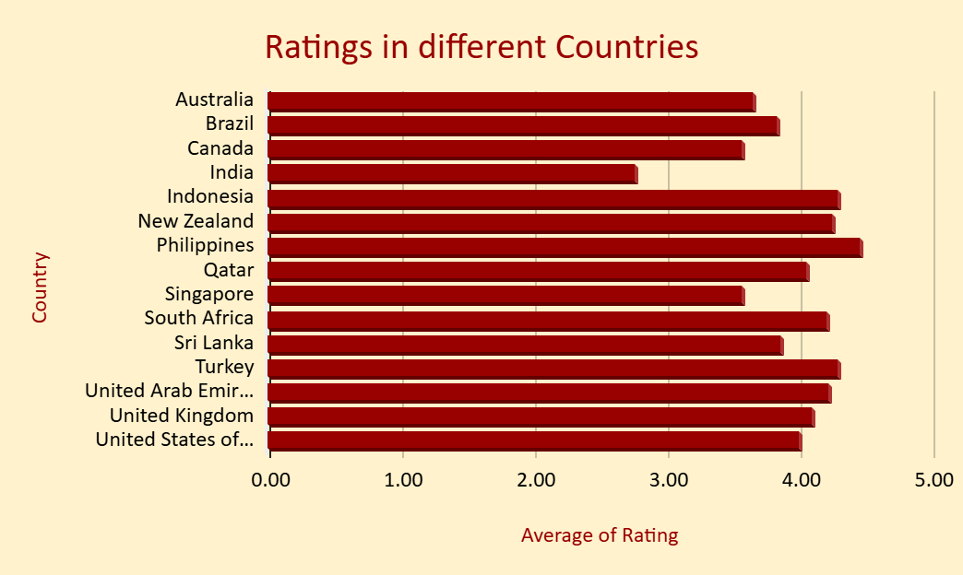
In the bar chart we can see the average ratings for different countries.
India is the least rated country and Philippines is the highest rated country in terms of quality of restaurants.
The United States is average rated i.e.4.
Clatskanie, Cochrane ,Fernley, Lakeview, Mc Millan are some few cities in the USA where company can open new restaurants because the number of restaurants in these cities is 1.Hence , competition is less and ratings are also good for USA.

Slide 10


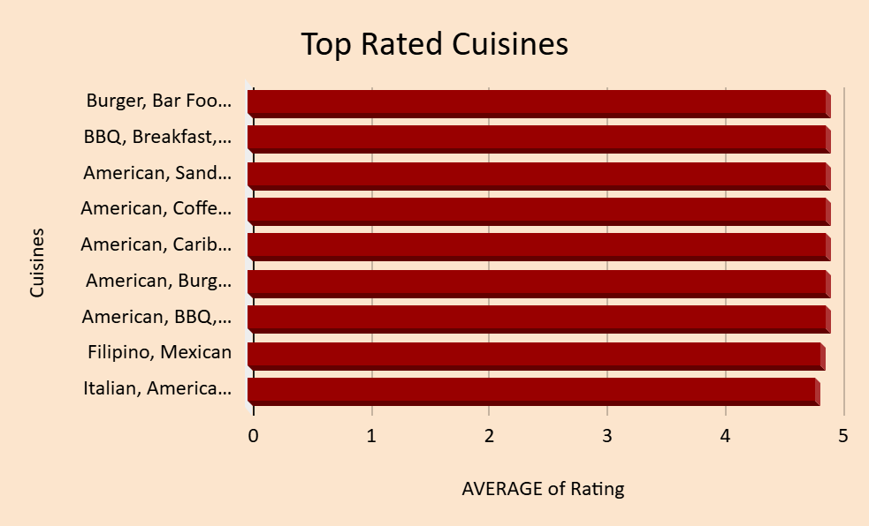
Cuisines to offer
These are the most popular top rated cuisines.
People prefer American, Mexican , Burger and Sandwich. So, we should include these in our menu.

Slide 11
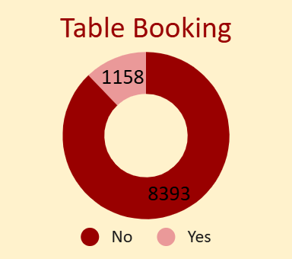
Should we provide table booking facility?
Yes
This donut-pie chart shows the number of restaurants that provide the facility of table booking.
We can clearly see that very few restaurants provide the facility of table booking.
So, we should definitely go with table booking to get better customer feedback.

Slide 12
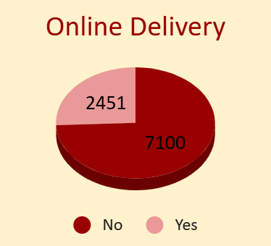
Should we provide online delivery?
Yes
This pie chart shows the number of restaurants that provide the service of online delivery.
Out of 9551 restaurants only 2451 restaurants provide online delivery.
Based on this analysis , we should go with online delivery to get better customer reviews and ratings.

Slide 13
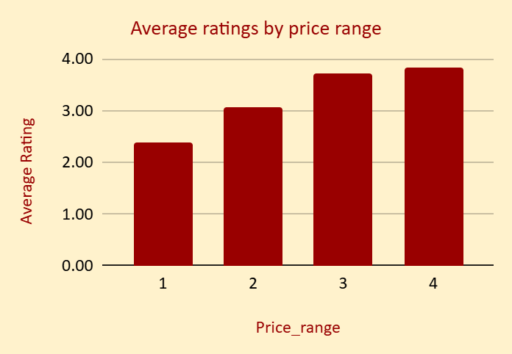
Ratings according to price
This chart represents the average rating based on the price range in different countries.
Ratings are lower for the cheapest restaurants.
The highest rating is 3.9 for the price range 4 and 3.7 for price range 3.

Slide 14

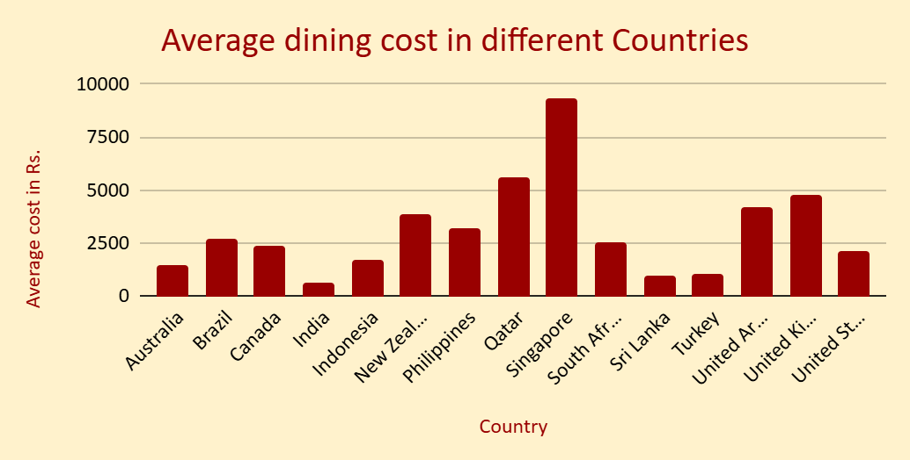
Expenditure-wise cheaper countries
This chart shows the average dining cost for two people in different countries.
These are the few countries where the dining cost is less.
Average cost for dining is cheaper in India i.e. approximately Rs.600 as compared to other countries.
In order to keep our financial expenditure in control we can open new restaurants in India because the dining cost is less also the expenditure on food would be less.

Slide 15

Recommended Countries:
Indonesia
New Zealand
Australia
United Arab Emirates
South Africa
Philippines
Sri Lanka
Turkey
Qatar

Slide 16
Why these places?
Limited Competition: With lower competition, these countries offer Zomato an opportunity to establish itself as a market leader and capture a significant share of the food delivery market.
Growing Demand: These countries have a growing demand for food delivery services, driven by increasing urbanization and a rising middle class, making them attractive markets for Zomato's expansion.
Positive Customer Sentiment: The high ratings (>3.5) in these countries indicate a positive customer sentiment towards food delivery services, suggesting that Zomato can leverage this goodwill to drive adoption and growth.

Slide 17
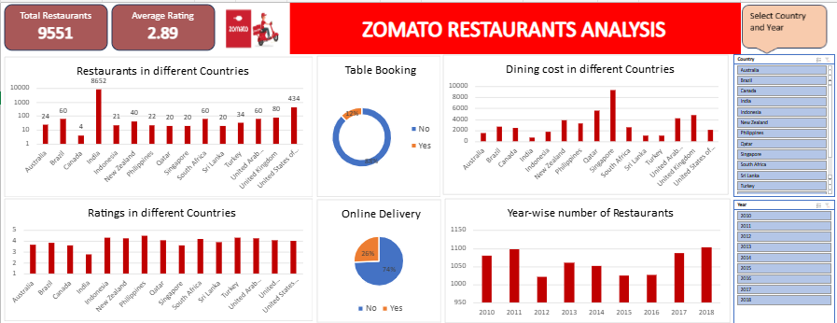
Dashboard

Slide 18
To find the most popular cuisine.
Identify target countries with high market potential.
Monitor operational efficiency and reduce costs.
Understand customer segments and tailor marketing strategies.
This dashboard can help you:
Evaluate marketing campaign performance and adjust strategies.

Slide 19
Conclusion
Market
Penetration:
Identified densely
populated
countries
and cities
highlighting
expansion
opportunities.
Customer insights:
Identified key
customer segments
including, popular
cuisines, ratings,
online delivery
facilities etc.
for better customer
reviews.
Highlighted regions for expansion
Where expenditure is less and profit is high.

Slide 20
In conclusion, this project demonstrates the power of data-driven decision-making in driving business growth. By leveraging data analytics and market insights, Zomato can inform its expansion strategy, optimize operational efficiency, and drive revenue growth. These findings highlight the importance of data-driven decision-making in today's fast-paced business environment.

Slide 21


